Slide 1
EECS151/251A Discussion
Christopher Yarp
Jan. 25, 2019

Slide 2
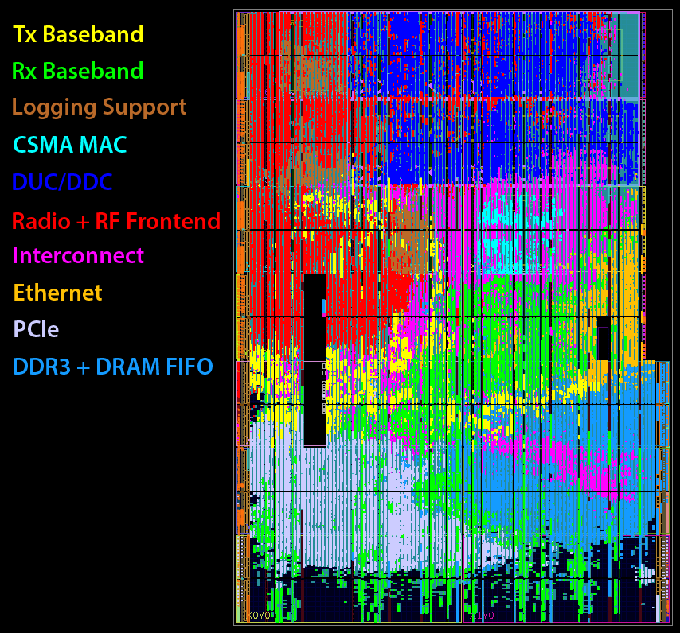

About me
5th Year Graduate Student
Advisor: John Wawrzynek
Work in the Berkeley Wireless Research Center (BWRC)
Prior Projects: Implementing Radio Basebands (DSP) in FPGAs
Current Research: Design Methodologies & Tools for DSP

Slide 3
My Job
To help you get the most of this course!
Running the discussion session
Running the FPGA lab sections
Answering questions in office hours and on Piazza

Slide 4
What to expect from discussion
Review of important concepts from past week’s lectures
Answer your questions!
More examples
Please give me feedback on what is helpful!

Slide 5
Textbook Resources
I may, from time to time, reference content from the Weste, Harris book mentioned in lecture
CMOS VLSI Design: A Circuits and Systems Perspective, 4th Ed.
The textbook is not required but does provide additional explanation and examples

Slide 6
Trends in Digital Design
Scaling Laws

Slide 7
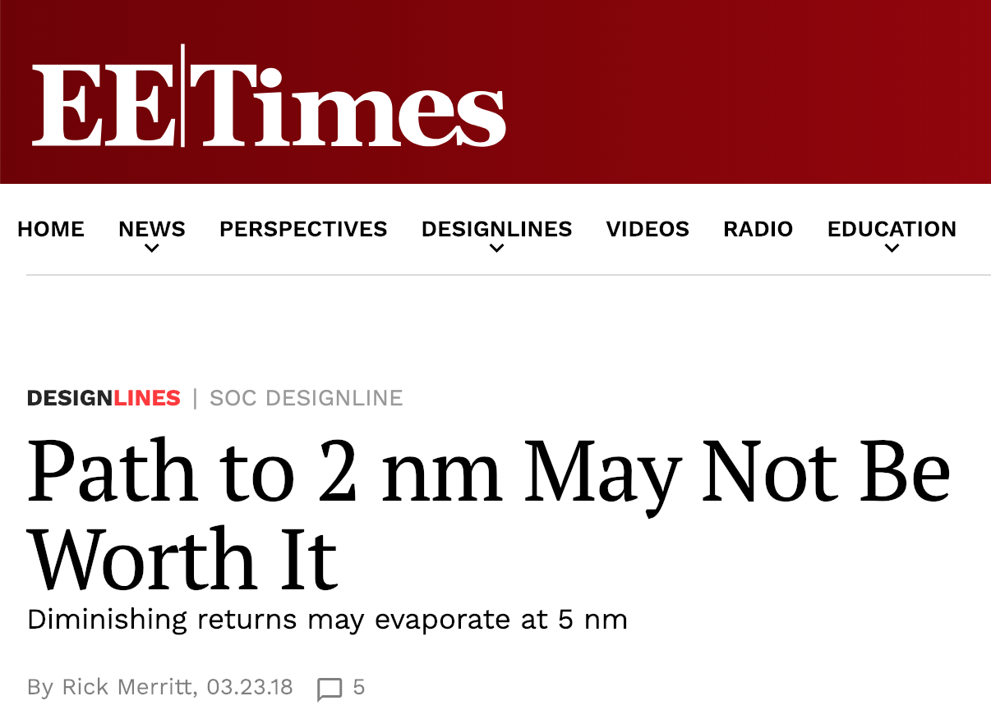
Moore’s Law
Number of transistors per ASIC die doubles every 1-2 years
Typically fueled by shrinking transistors to increase density
General view: Moore’s Law is coming to an end (or at least slowing)
Harder to scale the size of transistors to increase transistor density
Cost/transistor is not scaling as well as it used to
https://www.eetimes.com/document.asp?doc_id=1333109

Slide 8
Other ways of increasing transistor count
If it is harder to scale transistor sizes, what can we do?
Increase the size of the die!
Well … we could do this up to a point. Undesirable to make dies much larger
Large dies = poor yield = higher cost
Put more dies in a package!
AMD Threadripper (Released)
Intel 48-Core Cascade Lake (Announced)
Package (Opened)
Silicon Dies
AMD Threadripper “De-lidded”
https://www.extremetech.com/computing/253248-amd-threadripper-delidded-multi-core-surprise-hood

Slide 9
Dennard Scaling & Frequency Scaling
Dennard Scaling
Frequency Scaling
Voltage can be reduced as transistors are physically scaled down in size
Lower power
Capacitance also scaled down
Lower power, higher speed
Keeps power density constant, linearly improves delay (Weste, Harris 256)
Keep voltage constant as transistors are scaled (Weste, Harris 256)
Delay quadratically decreases (YAY!!)
Power density cubically increases (NO!!)
Generally stopped around 3-4 GHz
Encountered the “power wall” – cannot dissipate that much power

Slide 10
What do these laws mean for performance?
Moore’s Law
Performance may increase for a given chip area
Relies on parallelism
Why not 2x when doubling number of transistors?
Limited opportunities for parallelism
Overhead
Does your 4 core processor work 2x as fast as your last 2 core processor?
Frequency Scaling:
Performance did mostly scale with frequency
A 1.6 GHz processor performed approx. 2x better than 800 MHz processor without any change to architecture!
Don’t really see this today
Notes:
Ask John. Is Moore’s law really dead (is it transistors per die or transistors per package)? How about Dennard Scaling? Frequency scaling definitely is because of the power wall. It seems like we are scaling down the nominal Vdd of chips as processes scale down (although this is anecdotal to me. It seems true recently if you trust wikichip).
Does gate capacitance still scale? FinFet? Traditional Denard scaling would suggest that we would see linear increases in clock frequency. However, we don’t. Are we keeping frequency the same and decreasing voltage more than what would be required by Dennard scaling?
How about Vt, is it still scaling??
We havn’t talked about leackage.
Also, when talking about delay, should I mention net capacitance and speed of light?

Slide 11
Are transistors still scaling?
Yes
32 nm several years ago
14 nm today
7 nm today
5 nm planned
What are the effects?
More complex than traditional Dennard Scaling
Voltage appears to generally be decreasing
Clock speed not really changing

Slide 12
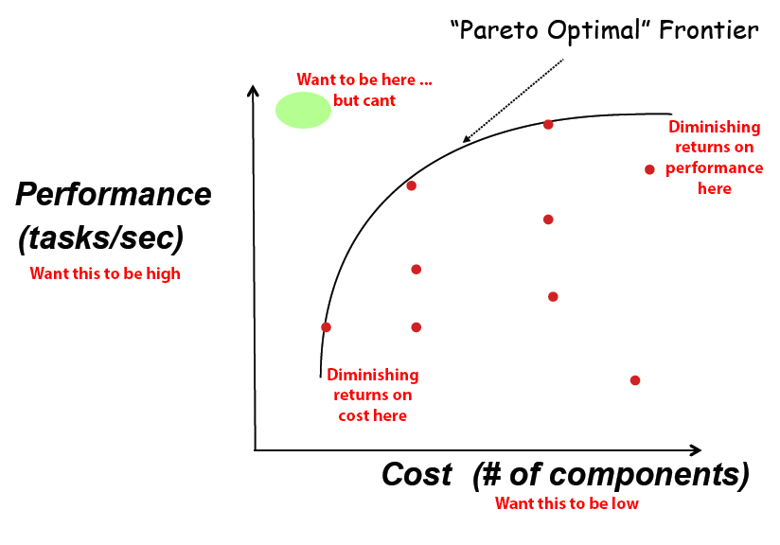
Design Space, Tradeoffs, and the “Pereto Optimal” Frontier
We often have competing objectives when designing hardware
High performance
Low power
Low cost
We usually can’t get everything we want - we need to make some tradeoffs
The “Perato Optimal” frontier represents the edge of the tradeoff space
Can’t to go beyond the “Perato Optimal” frontier

Slide 13
Logic Design

Slide 14
Combinational Logic
Logic where the outputs only depend on the current inputs
Do not depend on any previous inputs
Can be expressed using a Truth Table
Enumerate all possible inputs
Define the outputs
A | B | Out
0 | 0 | 0
0 | 1 | 0
1 | 0 | 0
1 | 1 | 1

Slide 15
Proving Equivalence with Truth Tables (Exhaustive Proof)
You can prove 2 circuits are (or are not) equivalent by comparing their truth tables
Useful for checking your work

Slide 16
Proving (or Disproving) Equivalence with Truth Tables (Exhaustive Proof)
C | B | A | A&&B | (A&&B)||C | Out
0 | 0 | 0 | 0 | 0 | 1
0 | 0 | 1 | 0 | 0 | 1
0 | 1 | 0 | 0 | 0 | 1
0 | 1 | 1 | 1 | 1 | 0
1 | 0 | 0 | 0 | 1 | 0
1 | 0 | 1 | 0 | 1 | 0
1 | 1 | 0 | 0 | 1 | 0
1 | 1 | 1 | 1 | 1 | 0
C | B | A | A&&B | !(A&&B) | !C | Out
0 | 0 | 0 | 0 | 1 | 1 | 1
0 | 0 | 1 | 0 | 1 | 1 | 1
0 | 1 | 0 | 0 | 1 | 1 | 1
0 | 1 | 1 | 1 | 0 | 1 | 0
1 | 0 | 0 | 0 | 1 | 0 | 0
1 | 0 | 1 | 0 | 1 | 0 | 0
1 | 1 | 0 | 0 | 1 | 0 | 0
1 | 1 | 1 | 1 | 0 | 0 | 0

Slide 17
Registers (State Elements)
Combinational logic is great but what about making decisions based on past inputs?
We need a way to store information!
Registers (FlipFlops) act as a storage element
Move the input to the output at a the 0 to 1 transition of a “load” line
There is some delay doing this
Hold the output until the next 0 to 1 transition of the “load” line
The “load” line is typically connected to the clock (clk)
D
Q
n
n
clk
D
0
1
2
Q
X
0
1
clk
Time

Slide 18
Register Transfer Level (RTL)
Can split your design into combinational logic blocks and state elements (sequential logic)
This abstraction covers all digital logic design
Does not cover every electronic circuit you could make
Combinational loops are not allowed
When one of the inputs to your combinational logic is the output
Ex: inverter wired to itself
This abstraction helps us when using HDL languages like Verilog!
Describe combinational sections
Describe sequential (state) sections
Comb. Logic
Comb. Logic
D
Q
clk
You may even have feedback from registers!

Slide 19
ASICs vs. FPGAs

Slide 20
ASIC vs FPGAs
ASIC
FPGA
Flexibility in placing standard cells during design
Can place exactly the cells you need
Arrays of General Logic Resources
Lookup Tables
Registers
Multiplexers
Memory
DSP Blocks
Interconnect Network
Programming the FPGA configures these general resources to implement your HW design

Slide 21
ASIC vs FPGAs
ASIC
FPGA
No unused logic -> you placed exactly what you needed
Inflexible after manufacturing -> only configurability is what you designed in
Design iteration time: months - years
High Fixed Manufacturing Cost (NRE – Non Reoccurring Engineering)
Designing and verifying
Limited flexibility -> better get the right design
Expensive to manufacture again -> avoid needing to fix things and manufacture again
Mask production (used during manufacturing)
Setting up the production line
Low Incremental Manufacturing Cost
Once the design is done and the production line is set up, producing more chips is not very expensive
Better sell a lot of chips to amortize the NRE!
Generality -> unused logic in some applications
Remains Flexible -> can change design later (reprogram FPGA)
Design iteration time: minutes - hours
Medium Fixed Cost (NRE)
Still HW design
More things to consider than SW
Relatively slow design tools
Medium Incremental Cost
FPGAs are general -> need larger die area to accommodate additional logic -> more cost/die
Good for lower volumes or when reconfigurability is required

Slide 22
Questions

Slide 23
ASICs vs FPGAs vs. Processors
Both FPGAs and Processors are ASICs. However, their applications are to be general deivices.
Pros
Flexible -> works for many needs
Reconfigurable (In most cases) -> program or FPGA design can be changed
Cons:
not every user will need every component of the ASIC.

Slide 24
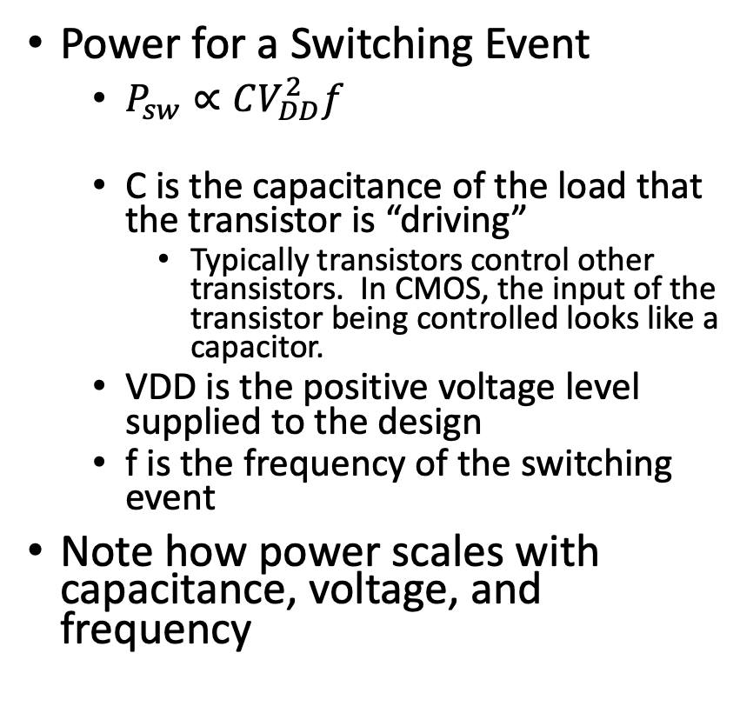
Power and Delay in Transistors
Power for a Switching Event
$P_{sw}∝CV_{DD}^{2}f$
C is the capacitance of the load that the transistor is “driving”
Typically transistors control other transistors. In CMOS, the input of the transistor being controlled looks like a capacitor.
VDD is the positive voltage level supplied to the design
f is the frequency of the switching event
Note how power scales with capacitance, voltage, and frequency
Delay
The delay is related

